Slide 1
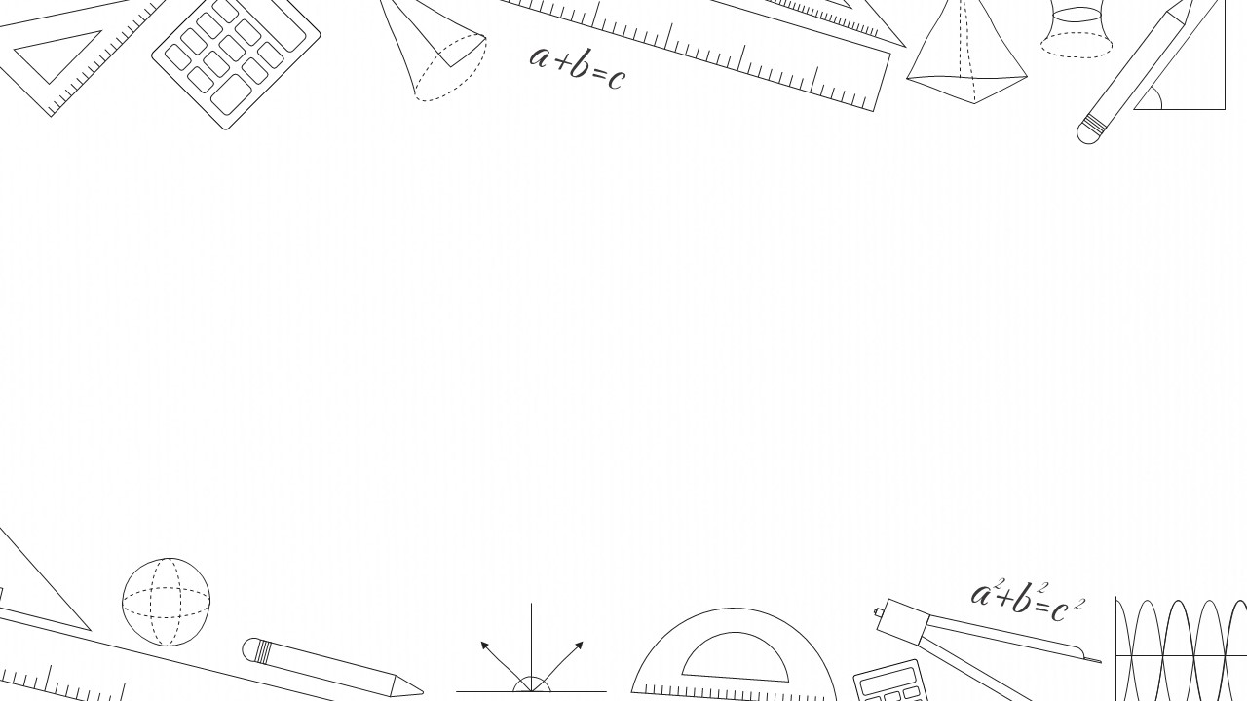
MathWorld

Slide 2
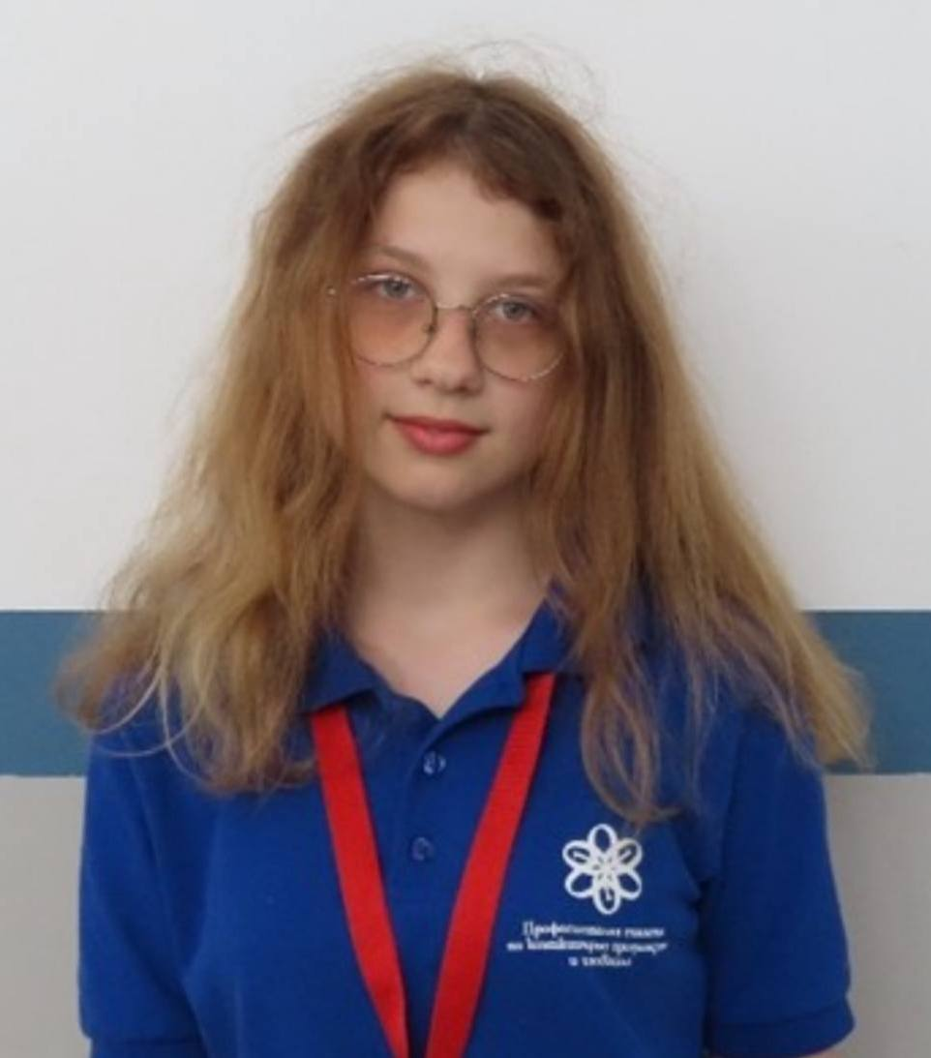
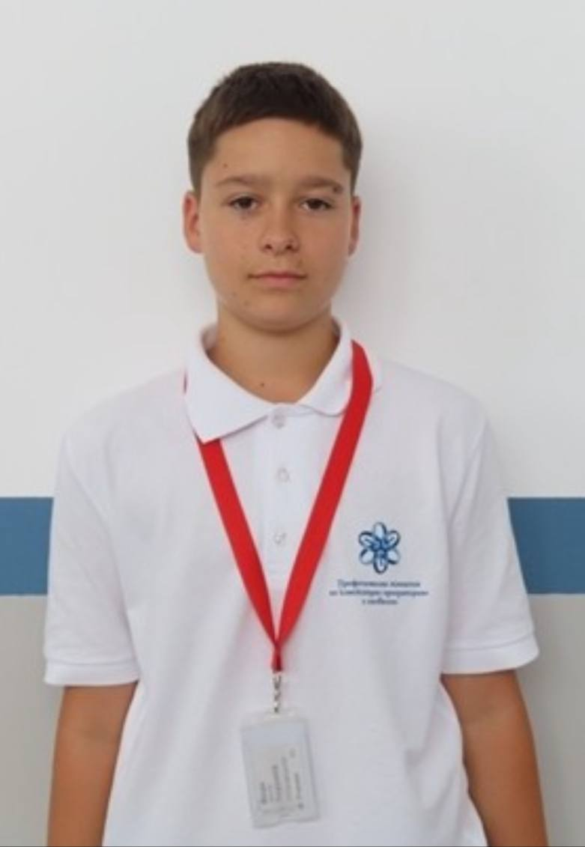
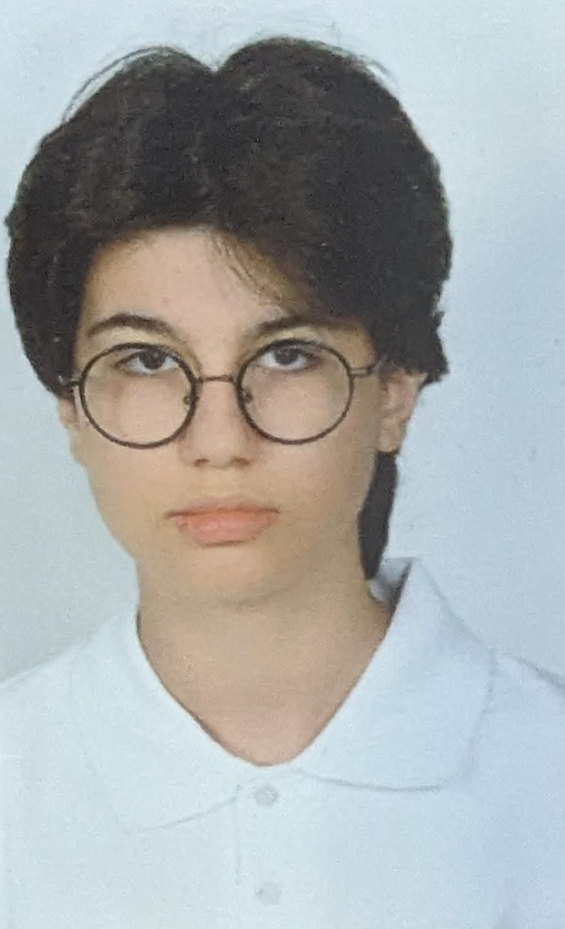
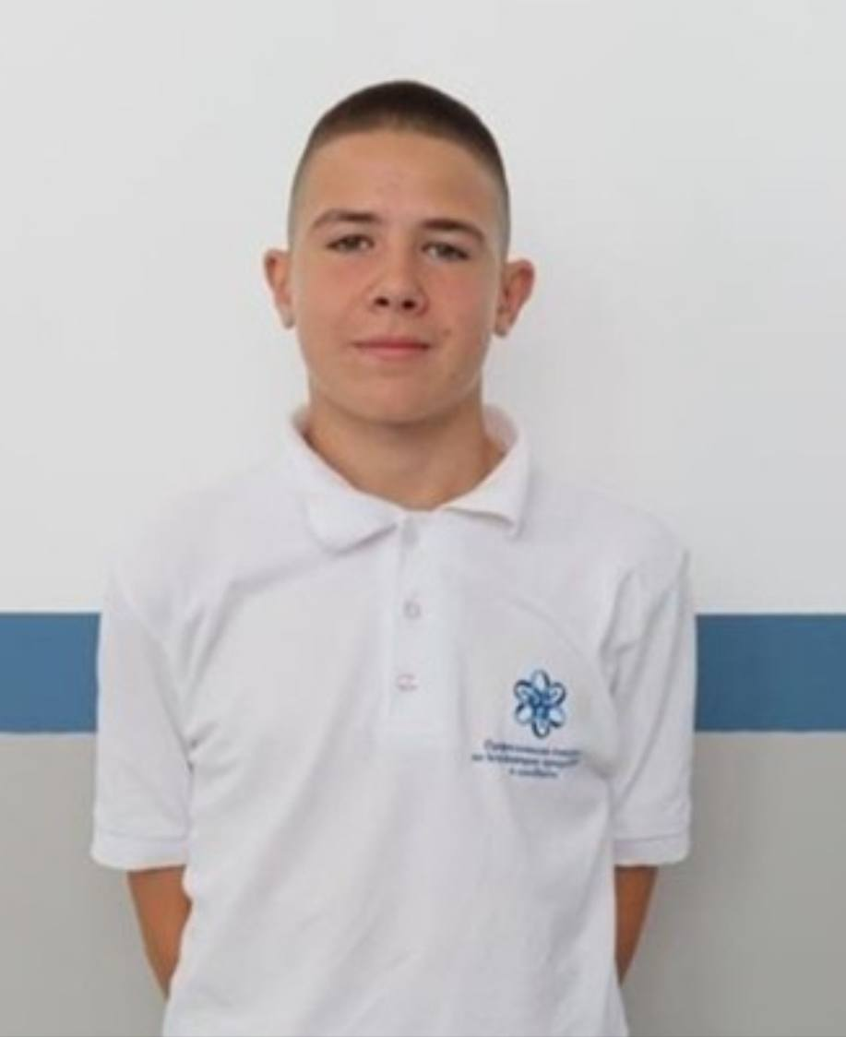
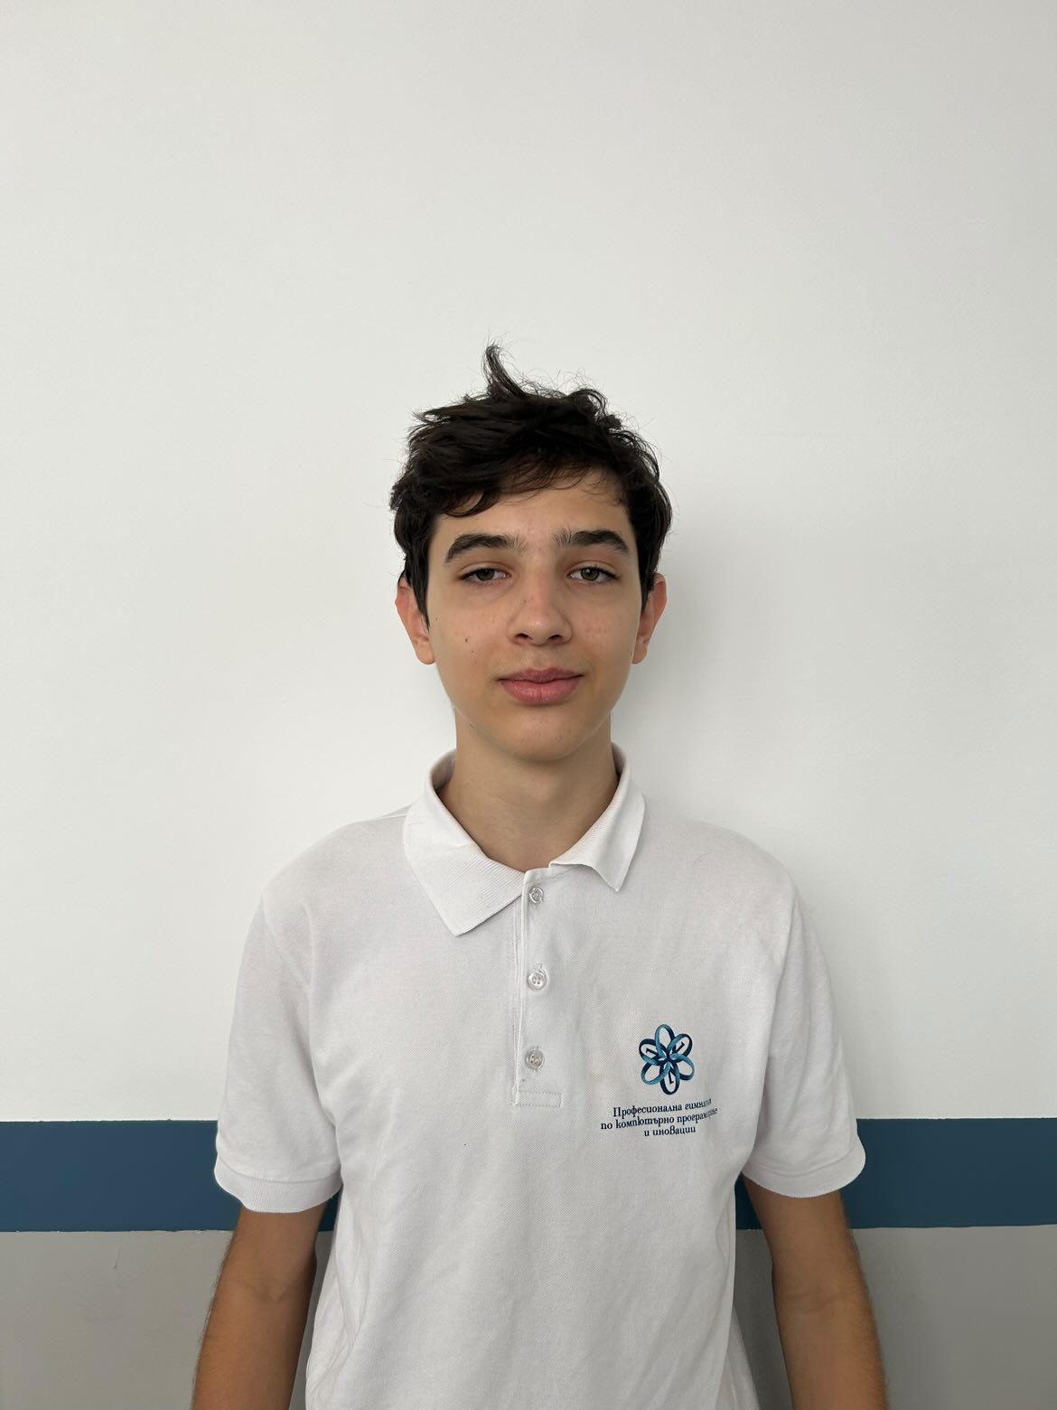
OUR TEAM
Leya Susova Front-end Developer
Yoan Yanakiev Front-end Developer
Roberta Hristova Scrum trainer
Teodor Enev Front-end Developer
Stiliyan Palazov Designer

Slide 3

OUR IDEA
Our idea is to create a website that will help students like us to learn more easily about biquadratic equations and to test their knowledge about them

Slide 4

STAGES OF REALIZATION

Slide 5








USED TECHNOLOGIES

Slide 6
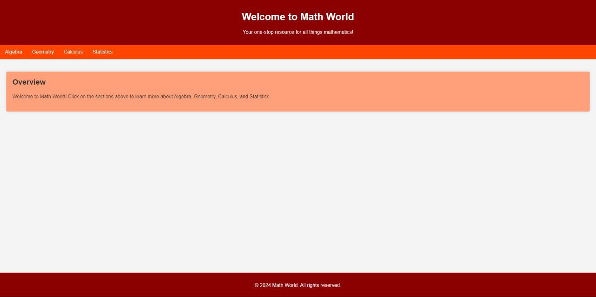
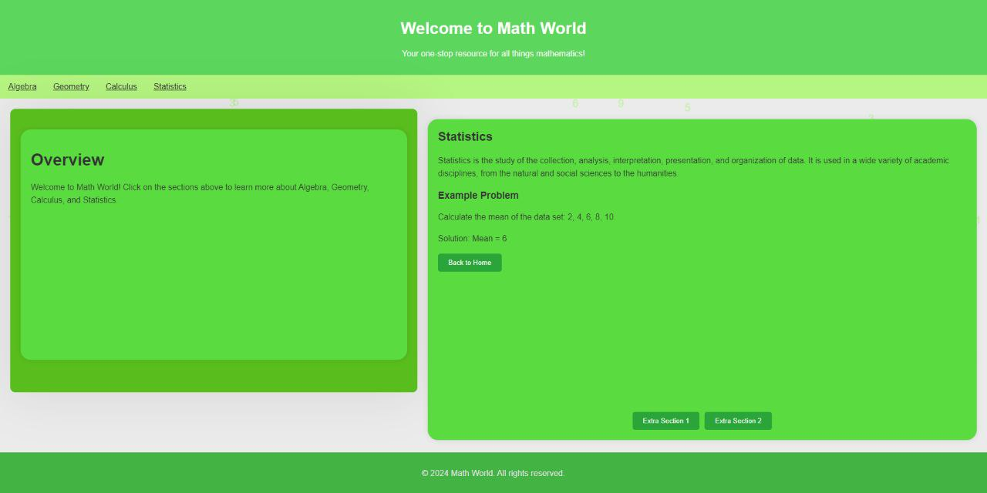
DEMO OF OUR PROJECT

Slide 7
Now let us show you our reposity!

